Slide 1

Distributed Computing in IoT:
System-on-a-Chip for Smart Cameras as an Example
Shao-Yi Chien1, Wei-Kai Chan1, Yu-Hsiang Tseng1, Chia-Han Lee2
V. Srinivasa Somayazulu3, Yen-Kuang Chen3
Paper Reviewed by:
MD ROBIUL ISLAM ID:22273004
Department of Computer Science and Engineering BRAC University

Slide 2
Distributed Computing in IoT
Four major components in IoT applications:
sensors,
communications,
computation, and
service.

Slide 3
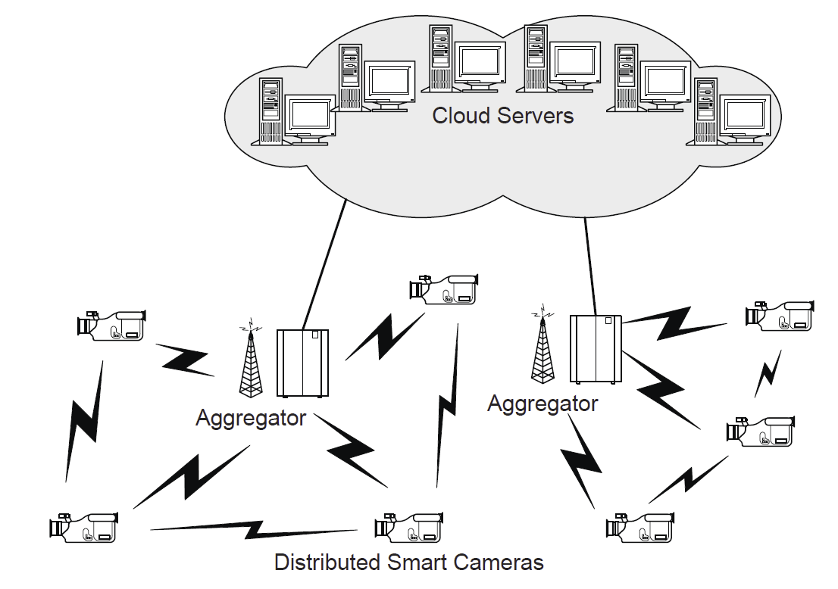
Distributed Computing in Video Sensor Network
Figure: Distributed smart camera as a node of an IoT.

Slide 4
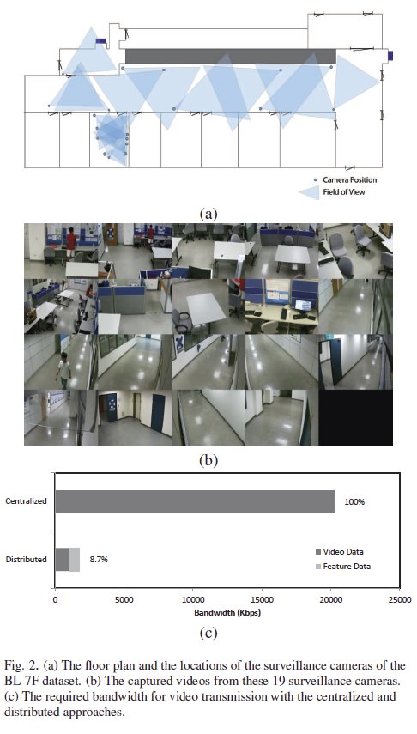
Distributed Computing in Video Sensor Network (Continued)
Video Surveillance

Slide 5
Motivation
Growing Demands for Advanced IoT Applications
Challenges with Traditional Solutions
Increasing Significance of Distributed Computing
Advancements in Silicon Technology

Slide 6
Contribution
Advancement of IoT Capabilities
Empowerment of Distributed Computing
Facilitation of Efficient Data Analysis
Illustration of Practical Applications

Slide 7
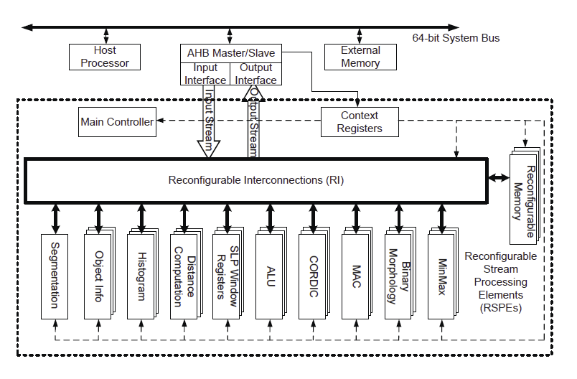
Methodology
Reconfigurable Smart-camera Stream Processor
Figure: Block diagram of the proposed reconfigurable smart-camera stream
processor.

Slide 8
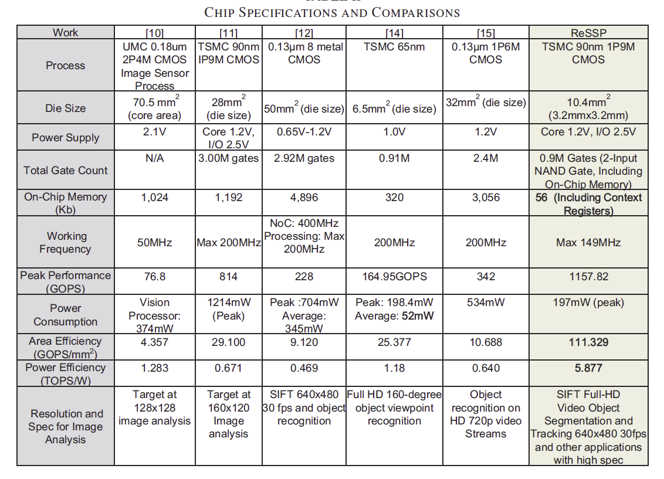
Results and Comparisons
Figure: Chip specifications and comparisons

Slide 9
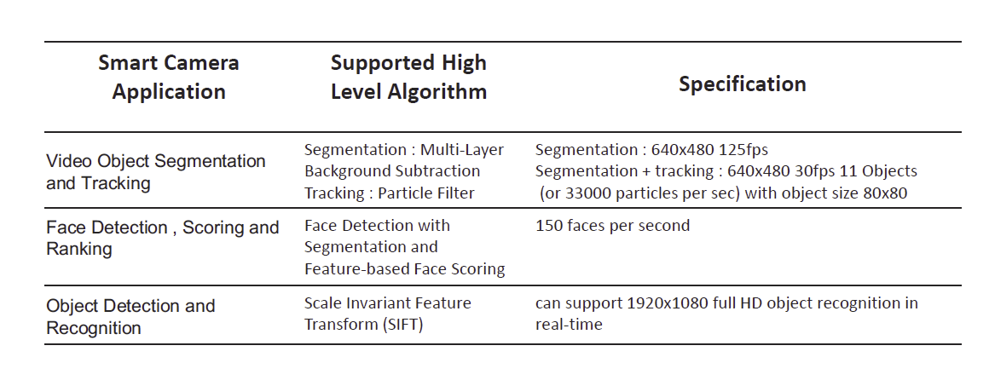
Results and Comparisons (Continued)
Figure: Performance of the Proposed processor

Slide 10
Conclusion
Challenges
Future works

